Slide 1
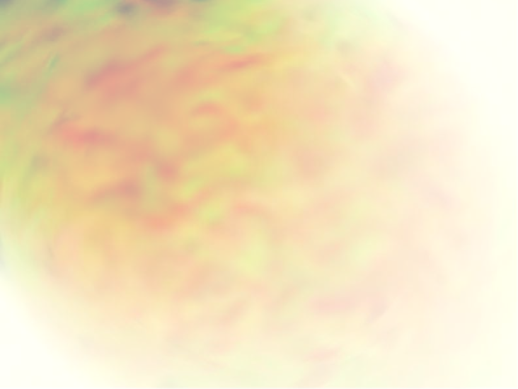




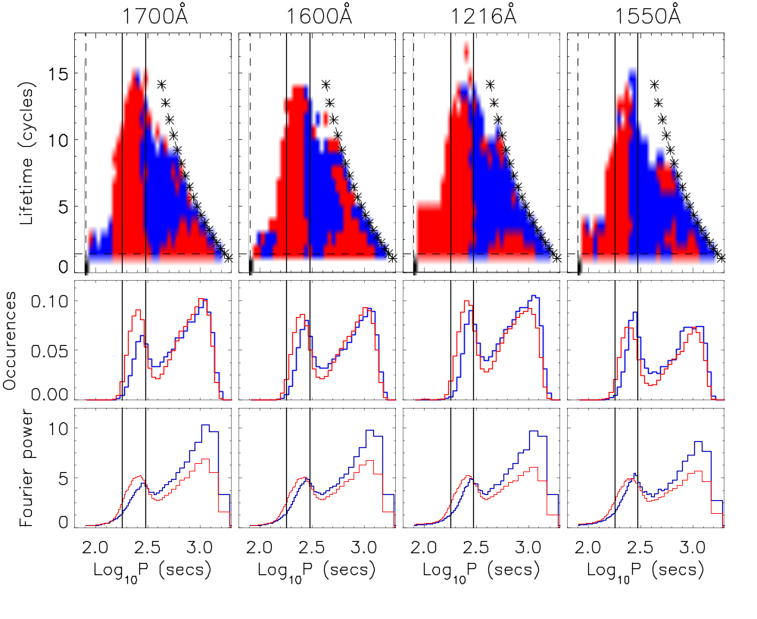
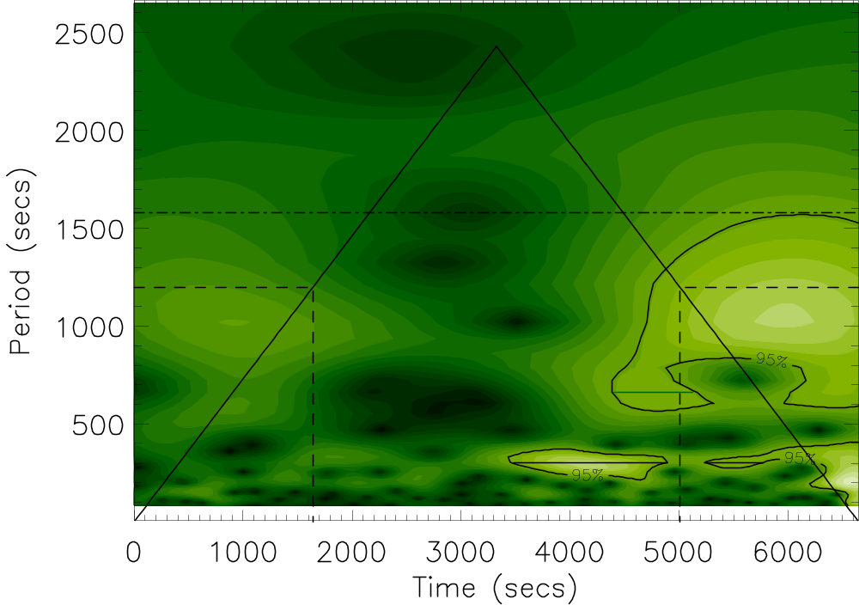
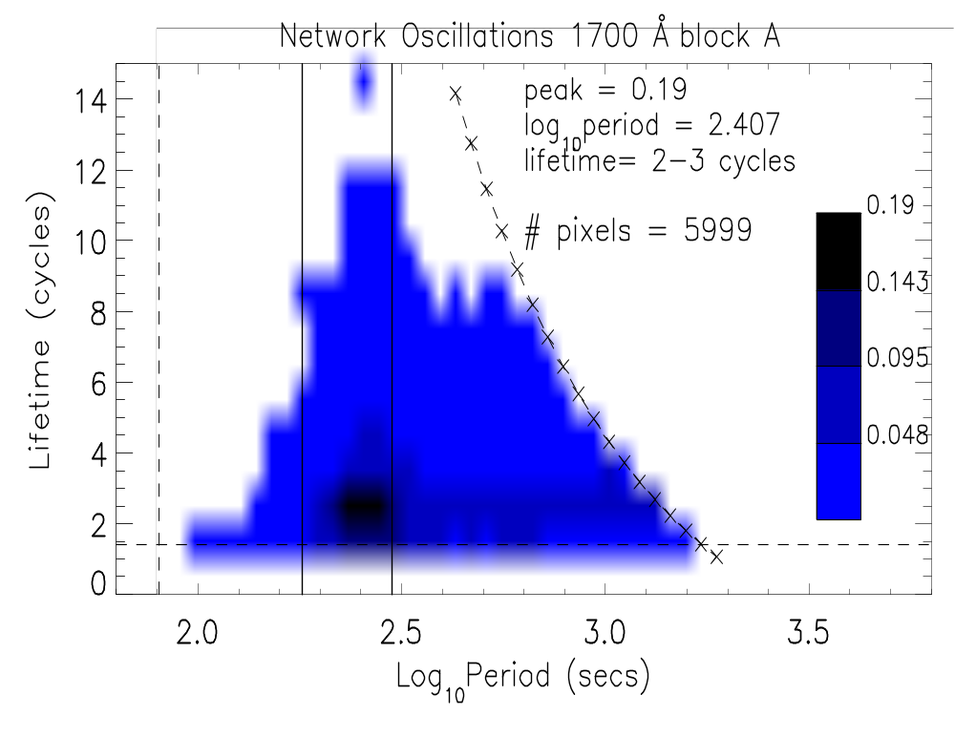
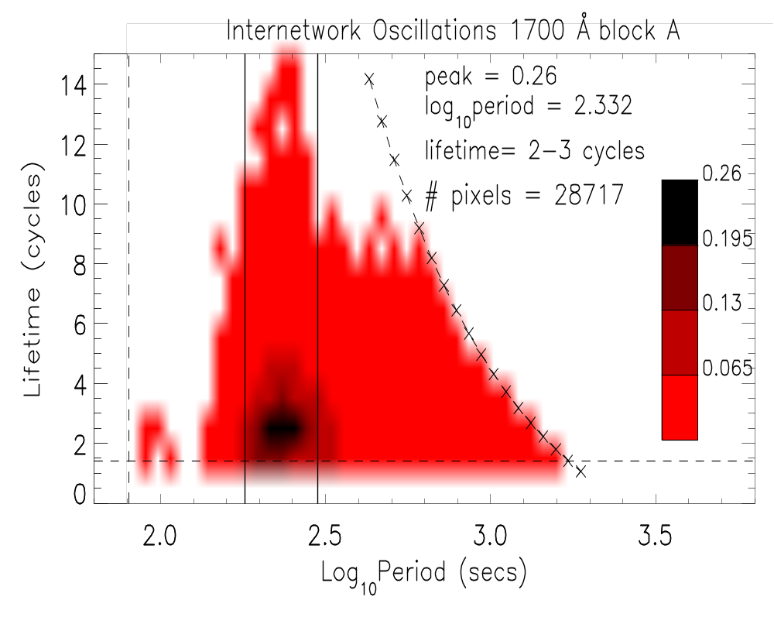
An Automated Wavelet Analysis Approach to TRACE Quiet-Sun Oscillations
R. T. James McAteer¹ ,
² L-3 Comms, NASA/GSFC, USA.
¹ Queen’s University Belfast, UK.
Peter T. Gallagher², D. Shaun Bloomfield¹,
³ Mullard Space Science Laboratory, UK.
David R. Williams³, Mihalis Mathioudakis¹, Francis P.Keenan¹
We present an automated wavelet analysis approach (originally applied to CDS data by Ireland et al. 1999) to Transition Region and Coronal Explorer (TRACE) quiet-Sun ultraviolet (UV) oscillations for both the network and internetwork, and discuss the results in each region in relation to possible heating mechanisms.
OBSERVATIONS: A quiet-Sun dataset (May 04, 1999 08:08 – 11:53 UT), with a cadence of 40.05 s in all 4 TRACE UV passbands (1700Ǻ, 1600Ǻ , 1216Ǻ, 1550Ǻ ) was aligned using cross-correlation techniques. Network and internetwork masks were created using techniques discussed in McAteer et al. (2001) and applied to all 4 UV passbands. This resulted in 5999 network lightcurves and 28717 internetwork lightcurves in each passband. The dataset was split into two 167 image sequences to facilitate the search for repeated oscillations at each period and lifetime.
WAVELET ANALYSIS: A wavelet analysis (using a Morlet wavelet; Torrence & Compo, 1998) was carried out on each lightcurve. An automated program was designed to search each wavelet power transform for power at greater than 95% significance for at least 1.41 cycles.
Figure 1: A wavelet power transform of a network lightcurve in 1700Ǻ. The slanted lines define the Cone of Influence (COI) above which edge effects are important. As the COI has duration of 1.41P at each end of the lightcurve at each period, P (dashed lines), the maximum possible detectable period is
P_{MAX} = 167x40.05 / 3x1.41 = 1642 s,
which is the indicated by the dash-dot line. Local maxima at greater than 95% significance (contoured) were located and their duration and periodicity recorded
Figure 3: Columns – left to right: ascending relative height of formation. Rows – top: Network has higher occurrence rate (blue), Internetwork has higher occurrence rate (red) at each period and duration. –middle: Occurrence rate summed over all lifetimes –bottom: Average Fourier power per pixel.
CONCLUSIONS.
All long lifetime oscillations (LLO; >8 cycles) occur in the acoustic band. These oscillations show no spatial memory (i.e. do not recur), hence the driver appears to be expending all its energy in creating the LLO.
The network has a higher peak periodicity (~290s) than the internetwork (~240s). The internetwork oscillations show a ~50% recurrence rate, suggesting a degree of spatial memory.
The peak in the network is less well defined - lower maximum occurrence rate of 0.19, and extended tail at 2-3 cycles up to P~1000s. This may be signature of kink mode waves in the network (Hasan & Kalkofen 1998, McAteer et al. 2002)
Fourier analysis shows that the network dominates at high periods (as in Krijger et al. 2001). But even in this high period regime, the internetwork exhibits more oscillations at low lifetimes.
FUTURE WORK: Automated algorithm is readily applicable to search for any non-stationary oscillations in large datasets. As such we plan to extend the work into other quiet-Sun and active region TRACE datasets, and to other space- and ground-based instruments.
Hasan & Kalkofen, 1999, ApJ, 512, 899
Ireland et al. 1999, A&A, 347, 355
Krijger et al., 2001, A&A, 379, 1052
McAteer et al., 2002, ApJ, 567, L165
McAteer et al., 2003, ApJ, 587, 806
Torrence & Compo, 1998, BAMC., 79, 61
\
Figure 2: Distribution of periodicity (in log₁₀) and lifetime (in cycles) of oscillations in the network (blue) and internetwork (red) for the first half of the 1700Ǻ data. Each figure is scaled to the maximum occurrence rate per pixel. The vertical lines are at 3 and 5 min. The crosses and dashed lines signify the maximum number of detectable cycles outside the COI at each period.
Notes:
2nd Year phd , QUB, supervisors
Collaborators - ex QUB, still fellows
Ken - supervisor of dave, peter

